Slide 1
Student services TEAM Prairie-Hills Junior high school

Slide 2
Welcome parents!!! The student services team of prairie-hills junior high school is made up of 3 school counselors, 3 social workers, 1 school psychologist & our district behavior interventionist/Tier III Wraparound coordinator

Slide 3
Our mission: Good mental health for all students
Good mental health is needed for overall well-being, and it can contribute to a student’s ability to find success in the world. Research demonstrates that students who receive social–emotional and mental health support achieve better academically. School climate, classroom behavior, on-task learning, and students’ sense of connectedness all improve as well.
Good mental health can help students to develop and maintain strong relationships with others, as well as an overall sense of contentment. It also allows them to deal with life’s challenges & the stressors in our daily lives too.
Mental health is not simply the absence of mental illness, but also encompasses social, emotional, and behavioral health and the ability to cope with any issues in a proper manner.

Slide 4
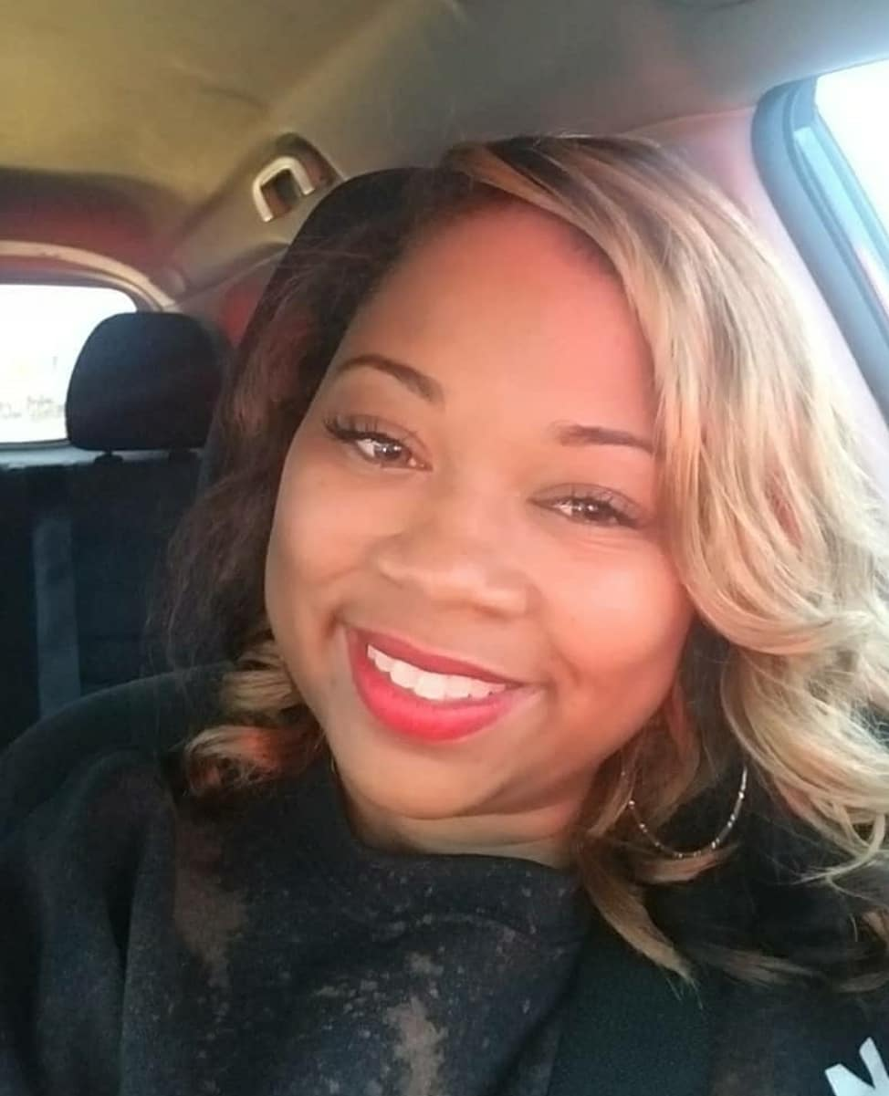
6TH Grade Counselor: Mrs. T. stewart-harris (Mrs. Harris)
Hi PHJH family!!! I’m Mrs. Harris, the 6th Counselor. What exactly does a school counselor do??? Well to simply put it, a school counselor is a professional helper. :) My job is to assist my students; to act as an advocate for their well-being, and as a valuable resource for their educational advancement. As a school counselor, first and foremost, I listen to students’ concerns and give them the additional guidance and support they may need in dealing with academic, personal, emotional, and social pressures. Some issues that I commonly deal with are bullying, conflict resolution, grief, organizational skills, & social media concerns, to name a few. Please contact me for any needed support!
Contact Info: Room A102
tstewart@phsd144.net
708-210-2860 ex. 2421

Slide 5
6th grade social worker:

Slide 6
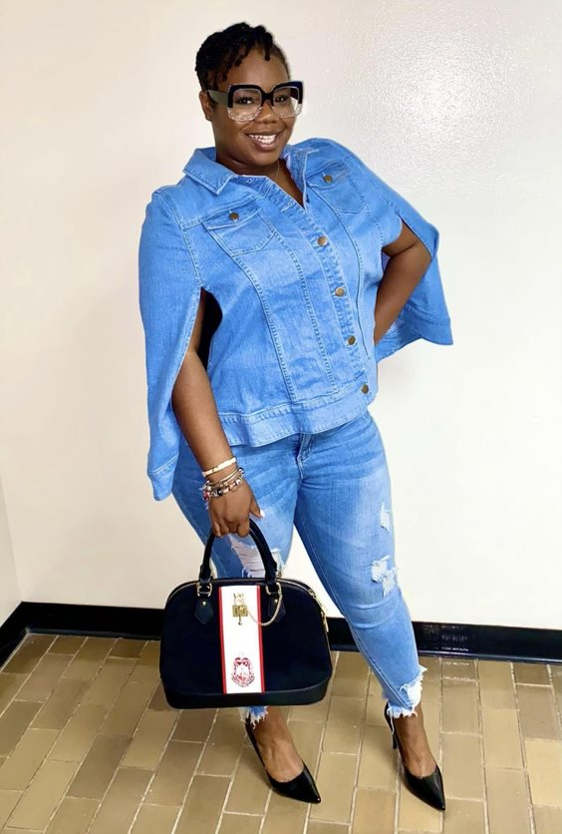
7th Grade Interim counselor: Ms. S. richie
Contact Info:
Room: A206
708-210-2860 ex. 2453
Email:
srichie@phsd144.net
Hello students and families! My name is Ms. Richie. I am your 2023-2024, 7th Grade Interim Counselor and a PROUD alumna of Prairie-Hills Elementary School District 144! In this role, I serve as an advocate and a professional helper for students. I find great joy and passion in establishing rapport and maintaining boundaries with students and staff. I am committed to supporting students’ ability to learn in a fun and safe environment. Please contact me for any of the following concerns:
Conflict Resolution
Bullying
Social Skills
Study Skills
Group Counseling
Individual Counseling
Goal setting

Slide 7
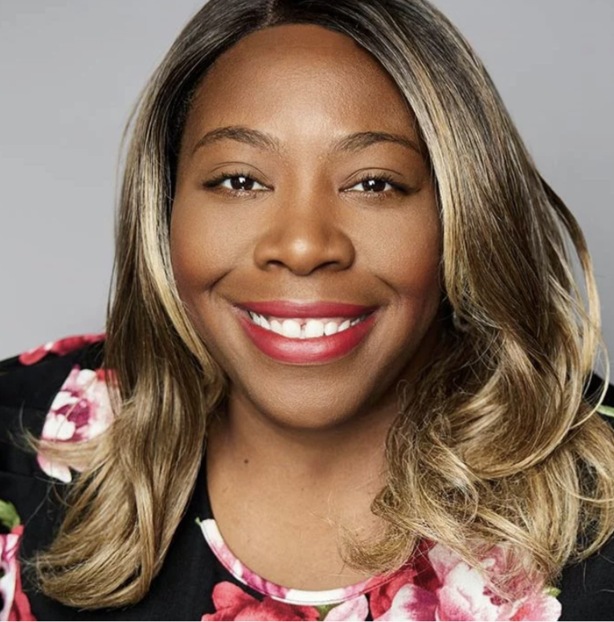
7th Grade Social Worker: Ms. brown
Hi,
My name is Shanita Brown. I am a licensed social worker. I graduated from the University of Illinois at Chicago (UIC) with my Masters of Social Work. I’ve been in the field for 17 years. I’ve worked in many school districts in elementary and high school settings. I’ve serviced children from ages 5 to 24. I like to teach students about the importance of positive thinking and follow a strength’s based approach. In my spare time, when I’m not working, I enjoy doing research, writing and traveling.
Contact Info:
If you would like to get in touch with me, you can email me at shbrown@phsd144.net or give me a call at (708) 210 - 2860 ext. 2452

Slide 8
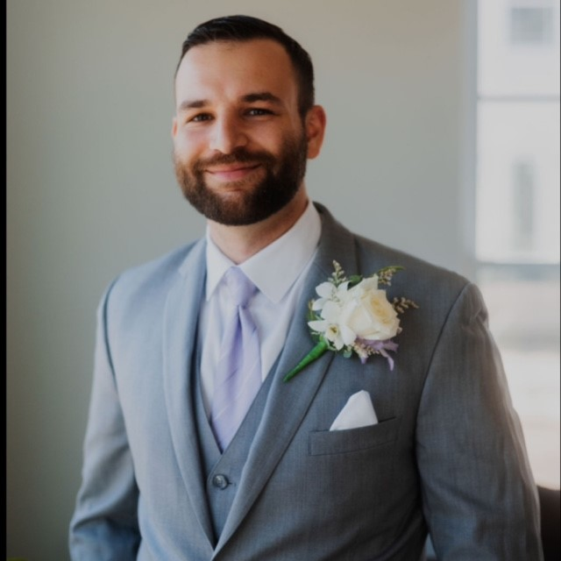
8th Grade counselor: Mr. z. cappos
Contact Info:
Room: B102
708-210-2860 ex. 2471
Email:
zcappos@phsd144.net
Hello! I’m Mr. Cappos and I am the 8th grade counselor. As a school counselor, I am here to support and advocate for students so that they can achieve academically, develop interpersonal skills, and become prepared for high school and beyond. Some examples of my duties include helping students develop academic skills such as planning, organization, and study skills, helping students resolve conflict or emotional difficulties, and teaching students about college and various career pathways. Please feel free to reach out as needed!

Slide 9
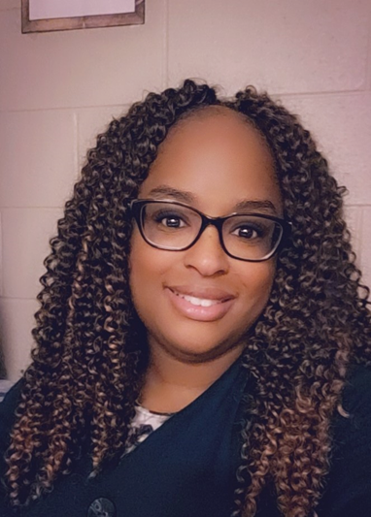
7TH Grade Social Worker: Ms. Boyd
Contact Info:
Room B104
708-210-2860 ext. 2472
mboyd@phsd144.net
This is my 5th year at PHJH. Social workers help students manage their emotions, behavior, peer and teacher relationships, and crisis situations. I also connect parents and teachers to resources that students may need in the school or community. Some of my responsibilities include:
Social Work Services for students with IEPs
Behavior Intervention
Individual Brief Counseling
Facilitating Social & Emotional Learning
Crisis Intervention
Parent & Teacher Consultations

Slide 10
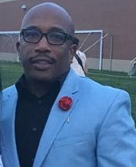
School psychologist: Mr. Thomas
Contact Info:
708-210-2860 ex 2307
mthomas@phsd144.net
Hello Everyone, I am Mr. Thomas, the School Psychologist. As the School Psychologist, I support students' ability to learn and teachers' ability to teach. I apply my expertise in mental health, learning, and behavior to help students succeed academically, socially, behaviorally, and emotionally. One of my main duties is to assess and evaluate students based on referrals by teachers & school administrators. This is mostly done for students struggling in a certain area.

Slide 11
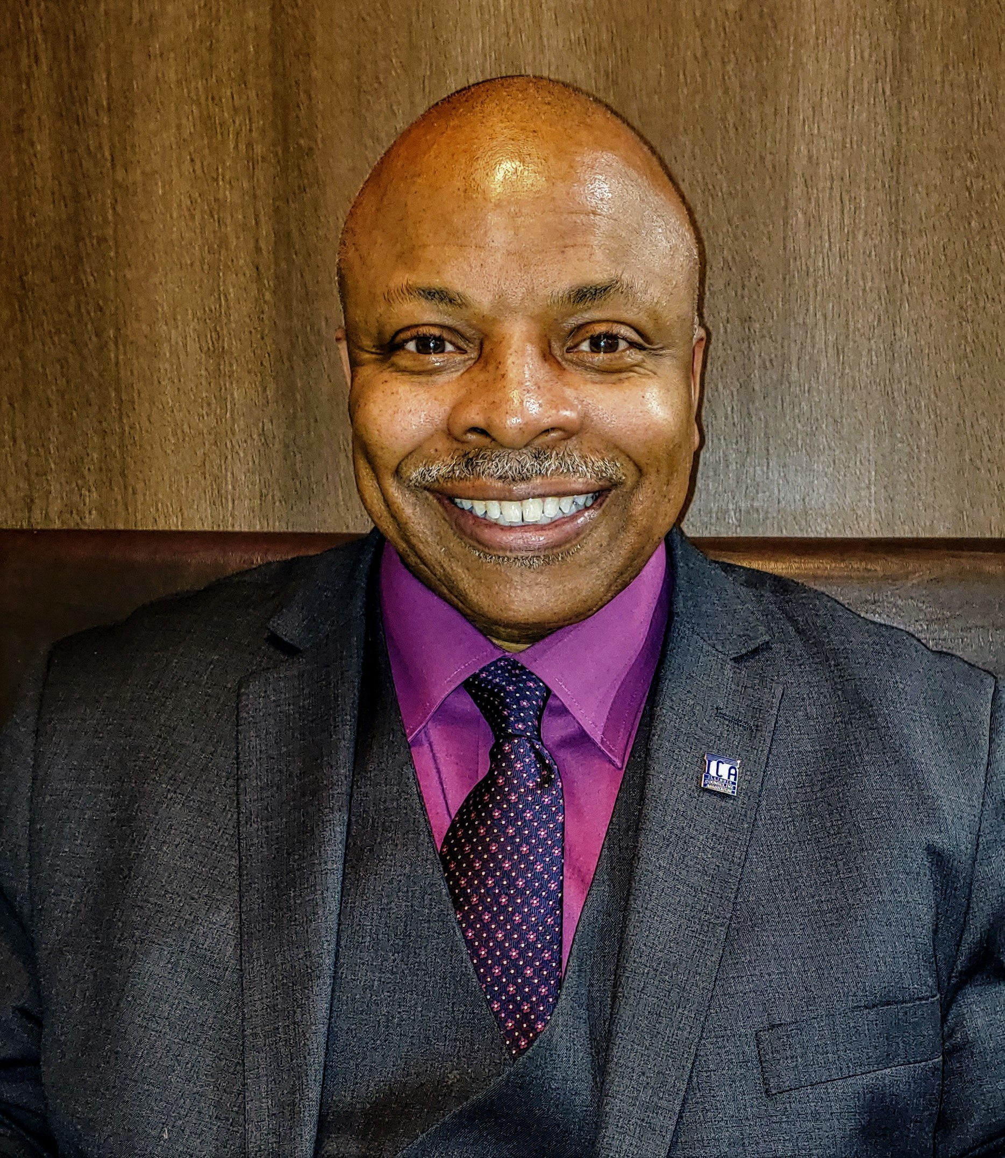
District Behavior interventionist: Mr. e. Harwell
I am the Prairie-Hills Dist. 144 Behavior Interventionist & Tier III Wraparound Coordinator. As the Behavior Specialist, I serve the student population in order to enhance their social, emotional, and peer relations. As the Tier III Wraparound Coordinator, I reach beyond the school campus in order to provide in-home and community support. The goal of my outreach is to make sure that I provide social, emotional & community support to each family.
If you are in need of additional support during the night or weekends, such as an unforeseen death in the family, then please don’t hesitate to give me a call. I am available to provide you with emotional support and resources. Thank you.
Contact Info:
eharwell@phsd144.net
708-296-0214

Slide 12
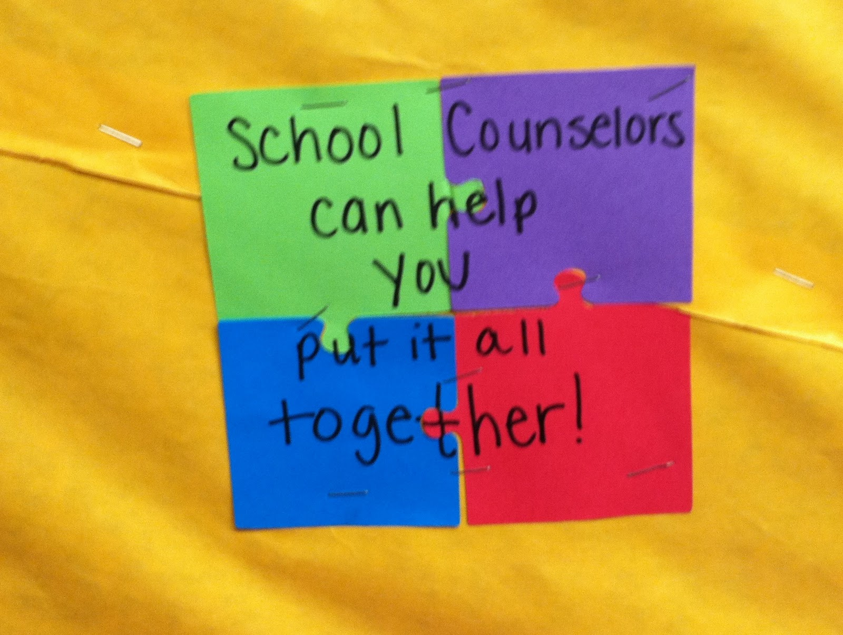
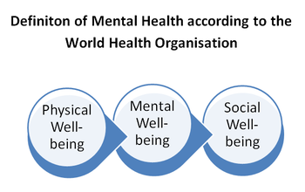
We are here to help…

